Slide 1

FULL ADDER
CIRCUIT
EEE 4134 (VLSI-I LAB)
[ GROUP 4]
19.02.05.088, 19.02.05.102 19.02.05.104, 19.02.05.190
19.02.05.192

Slide 2
INTRODUCTION

Slide 3
Full adders play a vital role in digital circuits, serving as essential elements for performing arithmetic operations.
Diverse circuit arrangements have varying effects on performance, power usage, and efficient use of circuit space.
This presentation dives into an examination of 4 Full-Adder designs: Conventional design, Transmission Gate design, Pass Transistor design, and GDI Full Adder design.
Through a comparative assessment, we will uncover the advantages and drawbacks of each design, providing insights into their respective strengths and limitations.
The goal is to identify the most suitable design for specific applications by carefully weighing trade-offs, aiming to achieve an optimal balance between different factors.

Slide 4
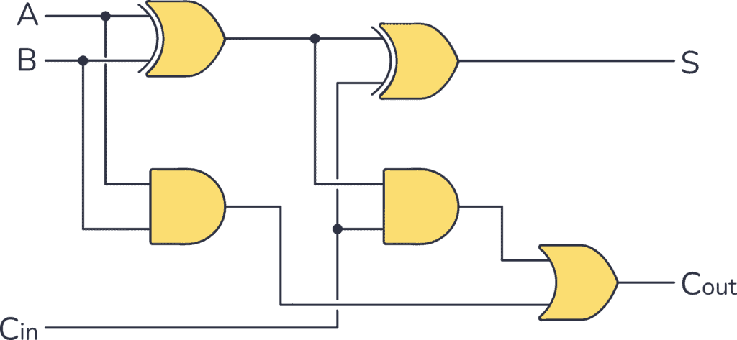
FULL ADDER
CIRCUIT

Slide 5
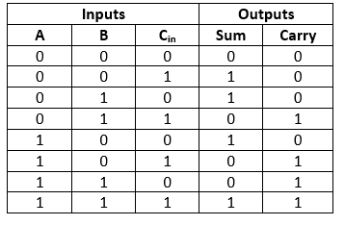
FULL ADDER
TRUTH TABLE

Slide 6
CONVENTIONAL
FULL ADDER (28T)

Slide 7
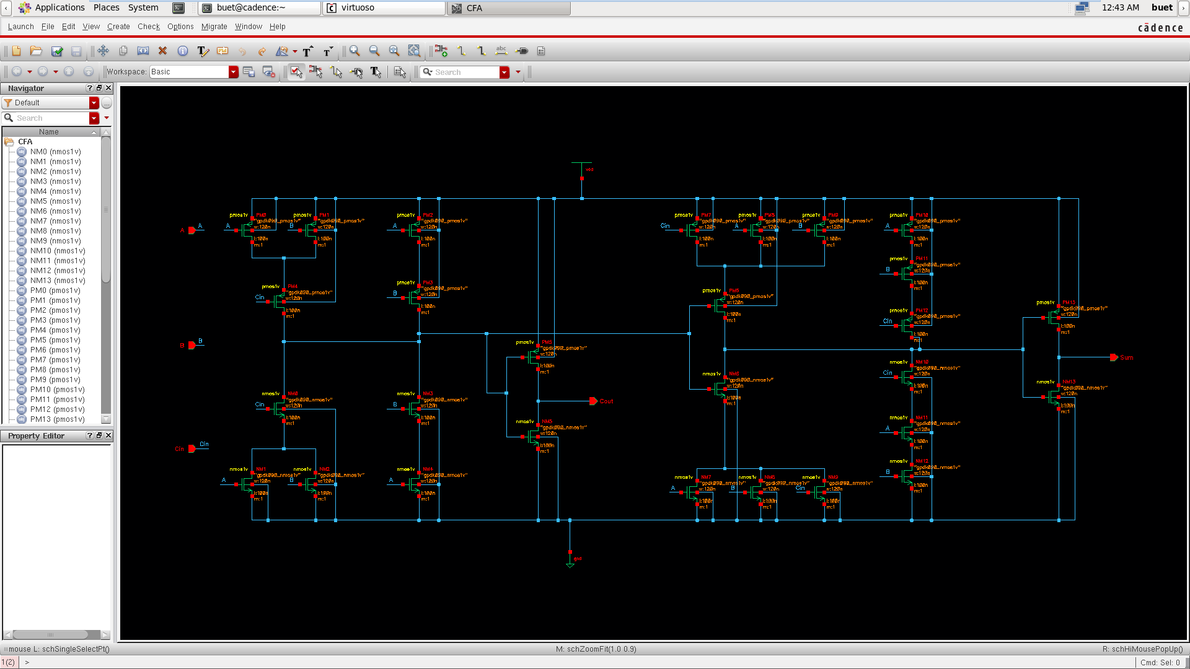
CONVENTIONAL
SCHEMATIC

Slide 8
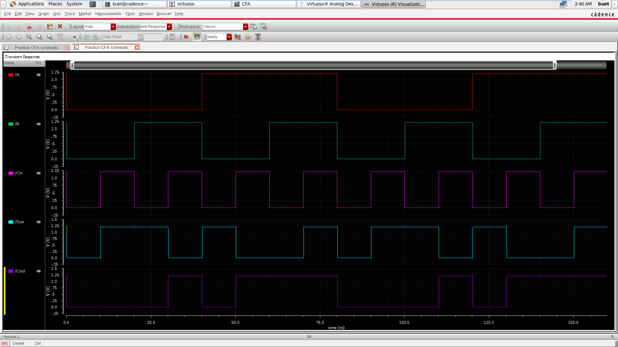
CONVENTIONAL
INPUT & OUTPUT WAVEFORM

Slide 9
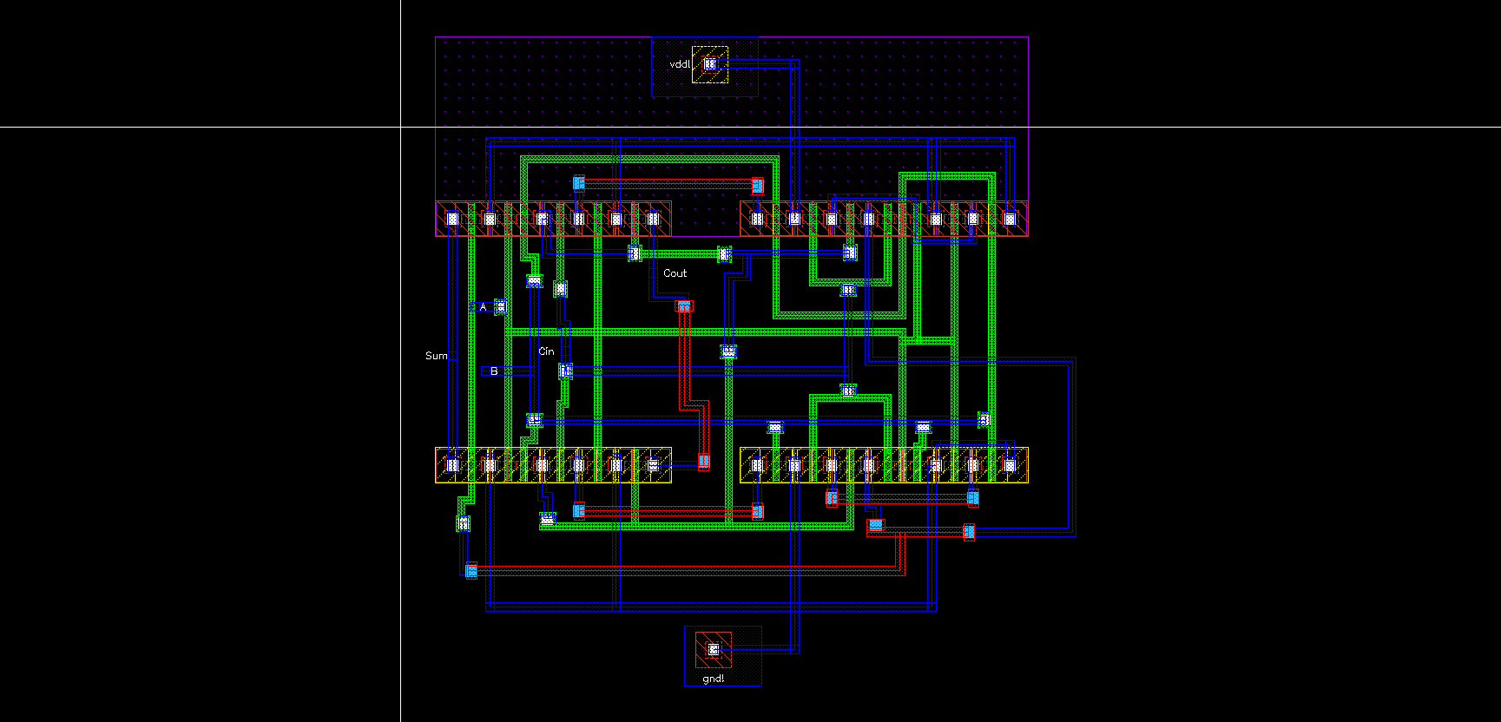
CONVENTIONAL
LAYOUT

Slide 10
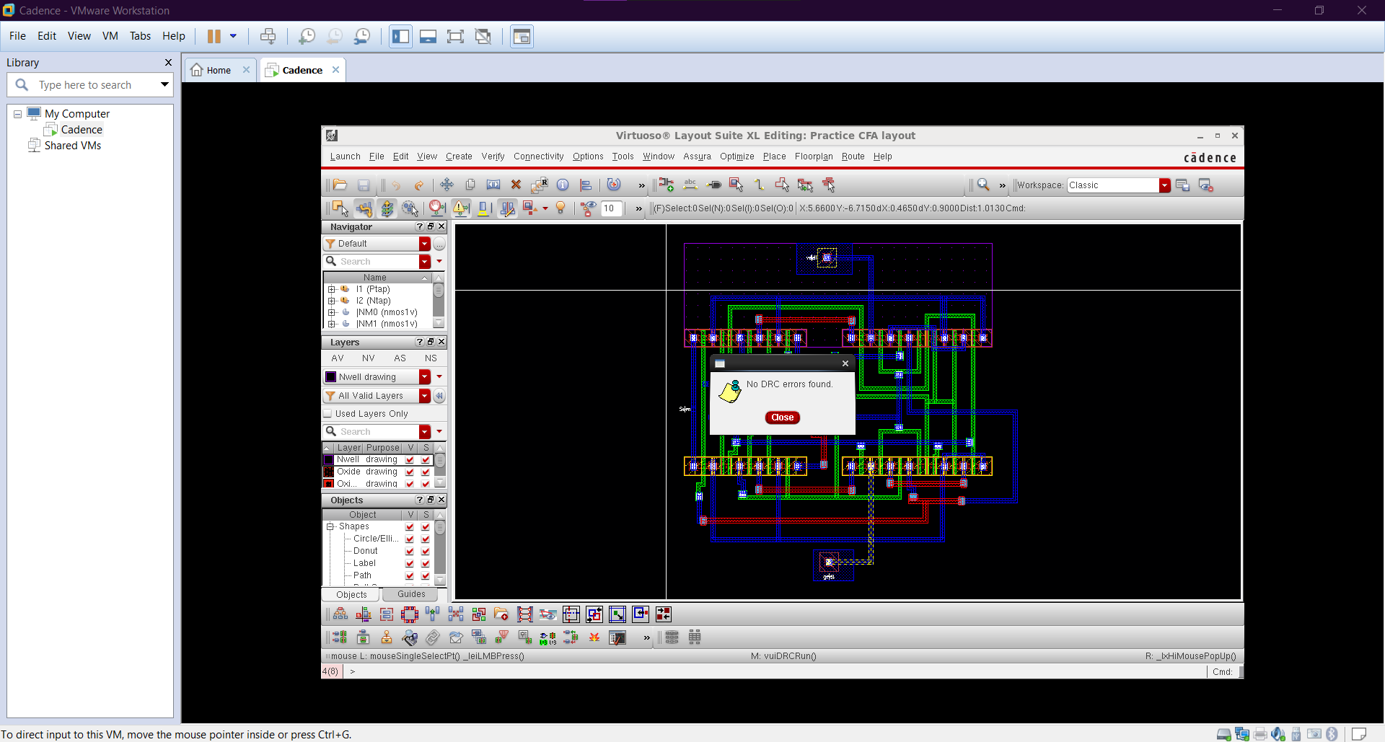
CONVENTIONAL
DRC

Slide 11
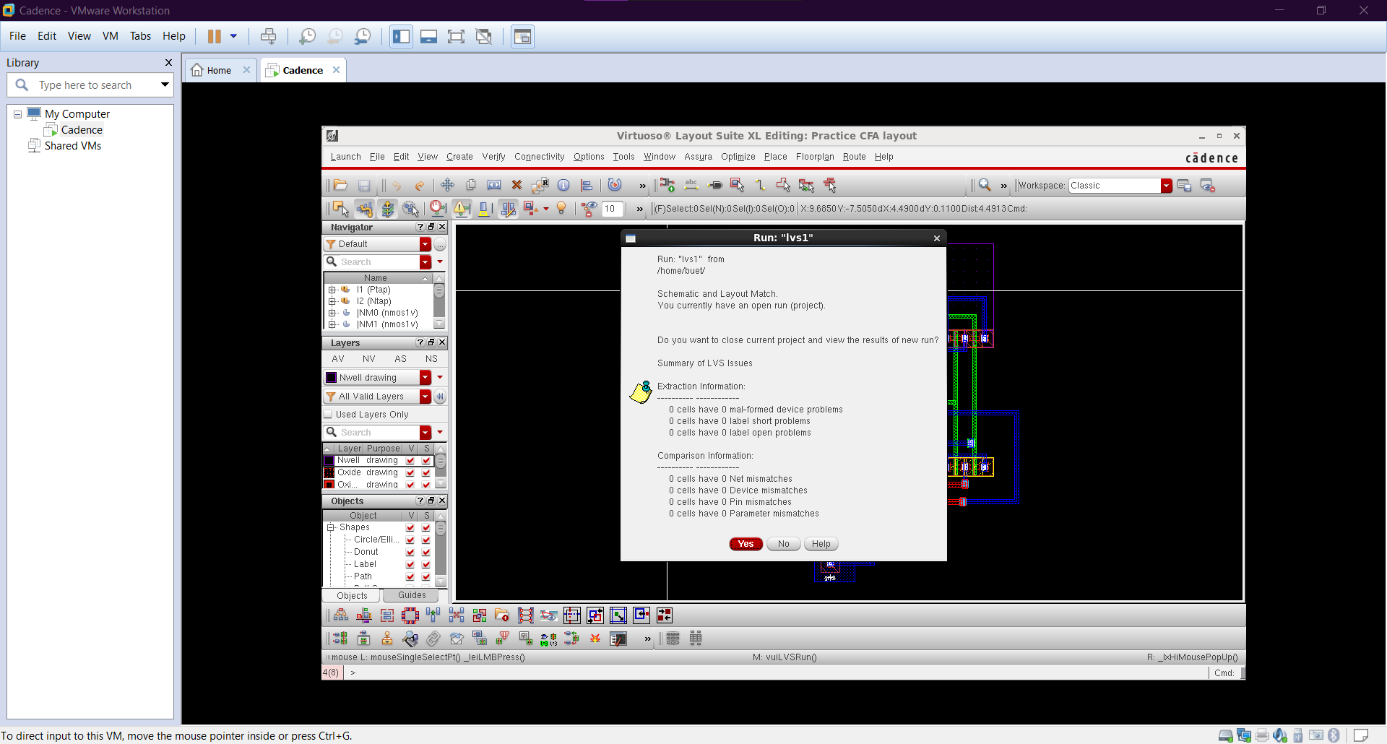
CONVENTIONAL
LVS

Slide 12
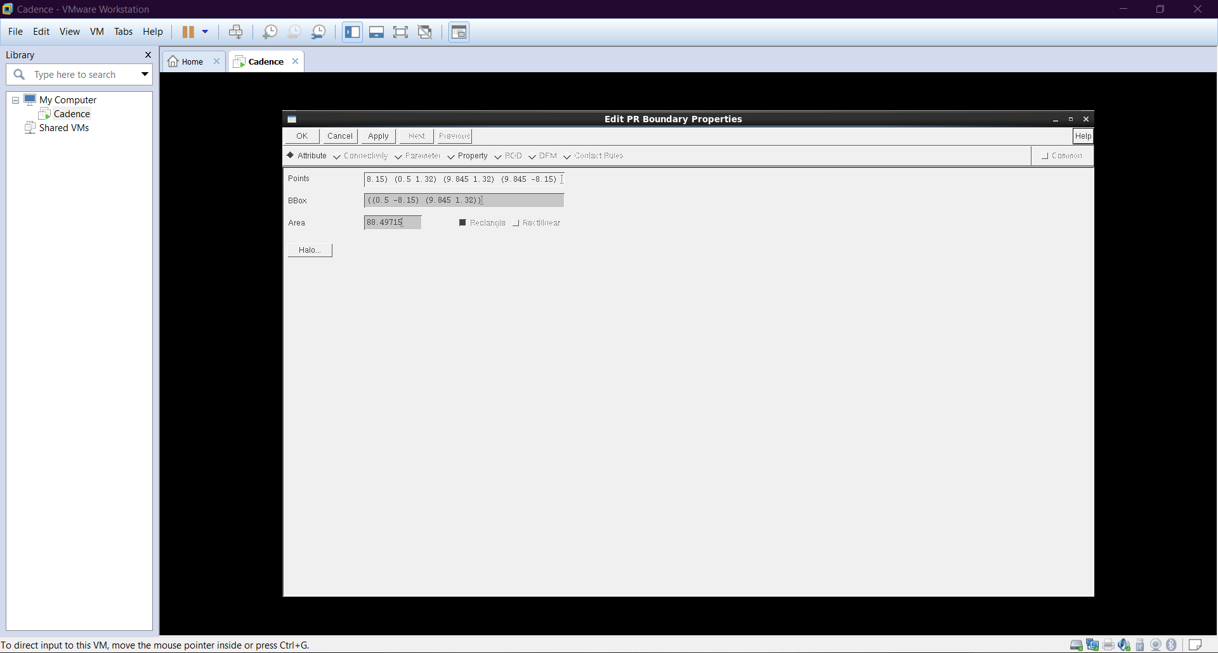
CONVENTIONAL
CELL AREA

Slide 13
TRANSMISSION GATE
FULL ADDER (20T)

Slide 14
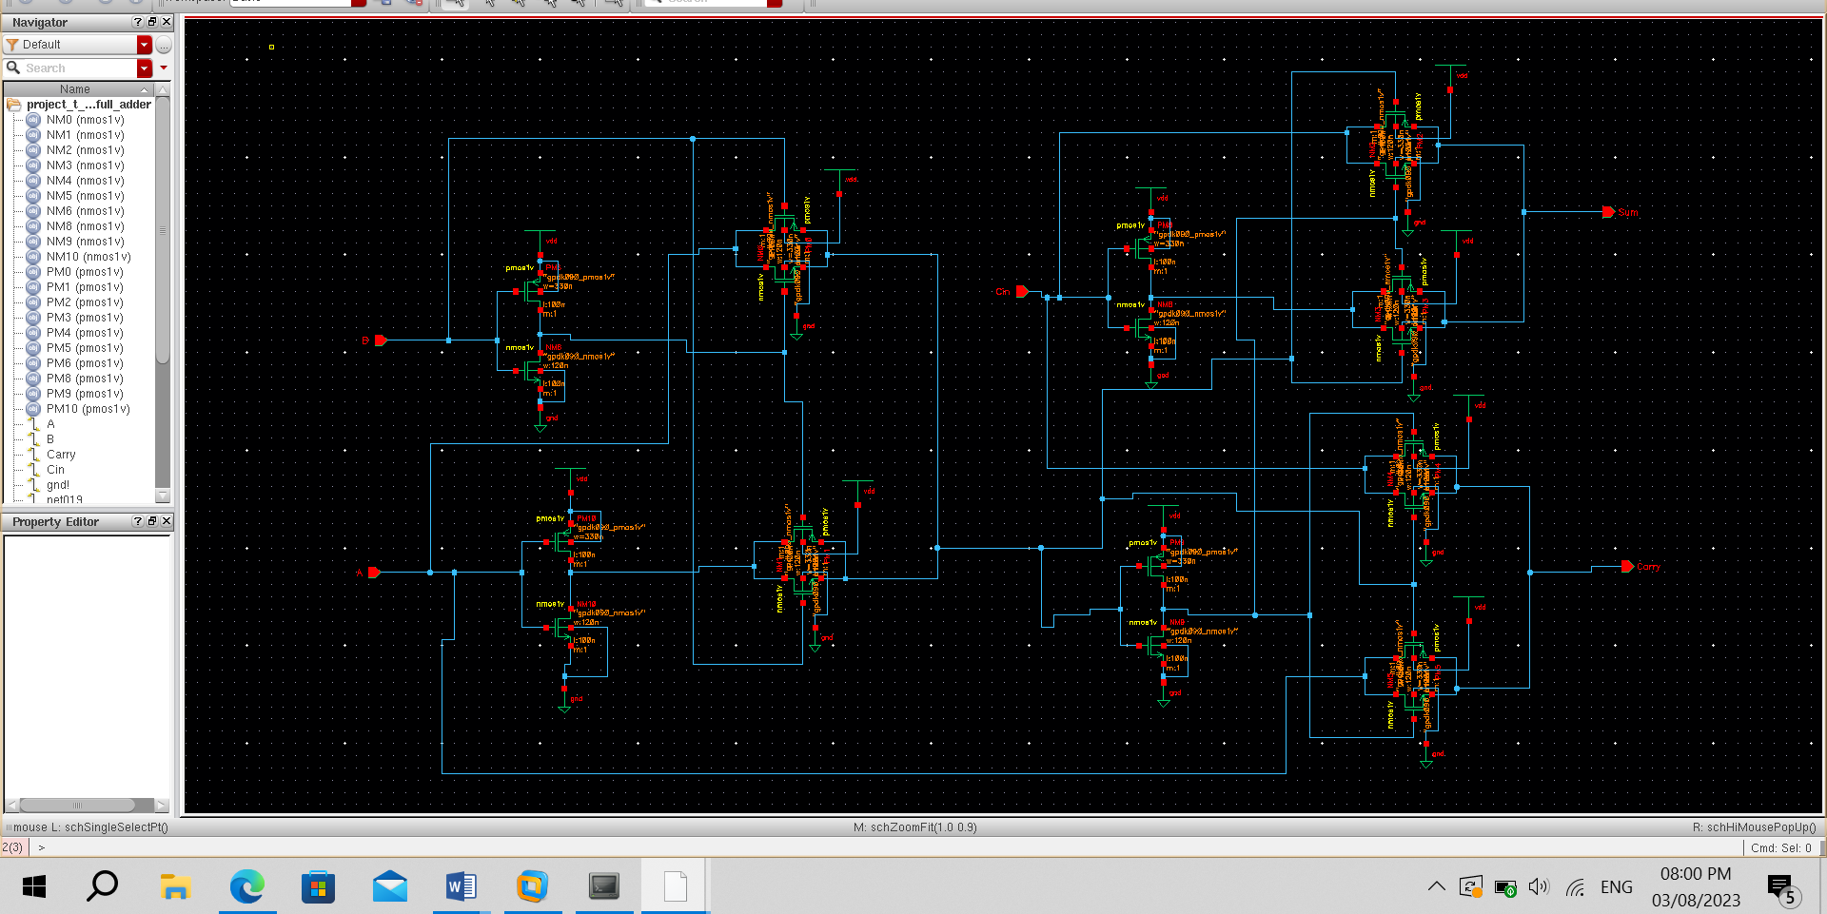
TRANSMISSION GATE
SCHEMATIC

Slide 15
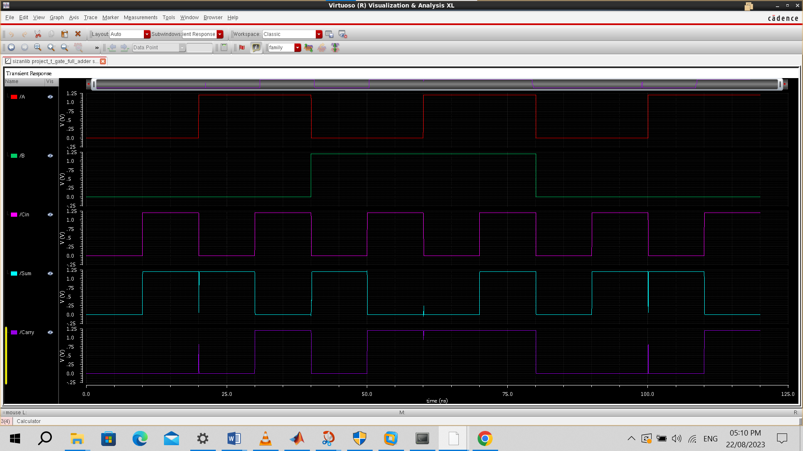
TRANSMISSION GATE
INPUT & OUTPUT WAVEFORM

Slide 16
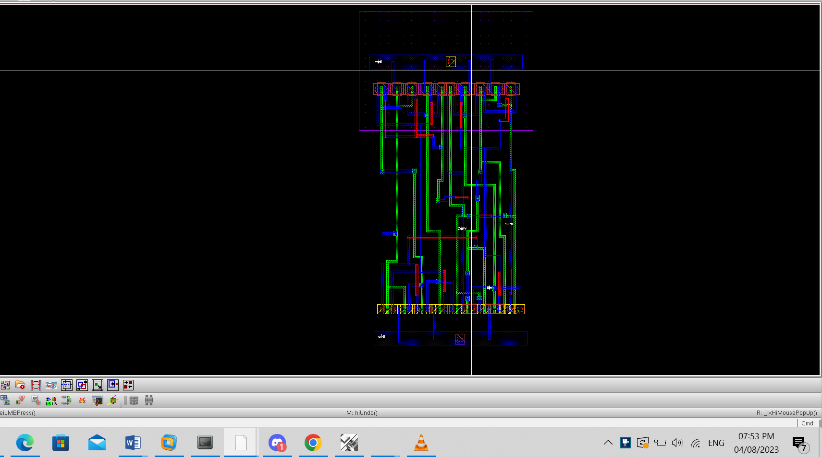
TRANSMISSION GATE
LAYOUT

Slide 17
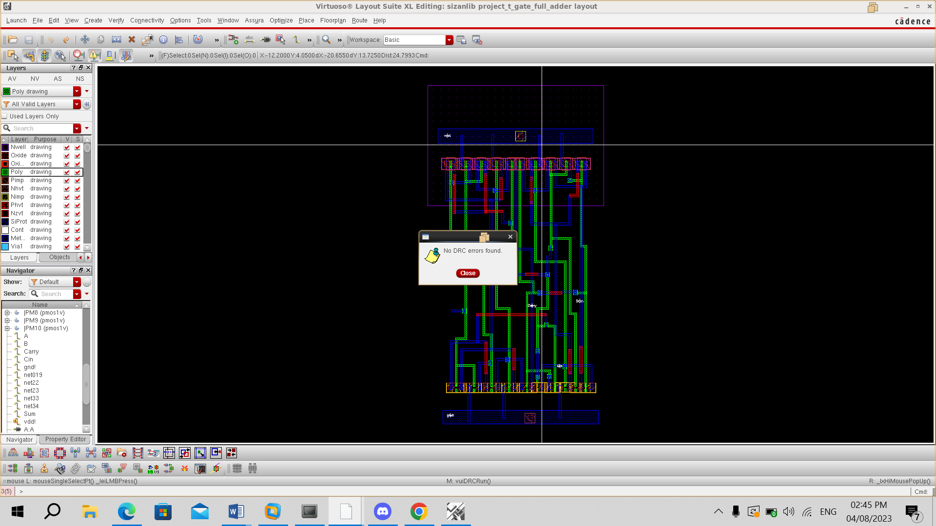
TRANSMISSION GATE
DRC

Slide 18
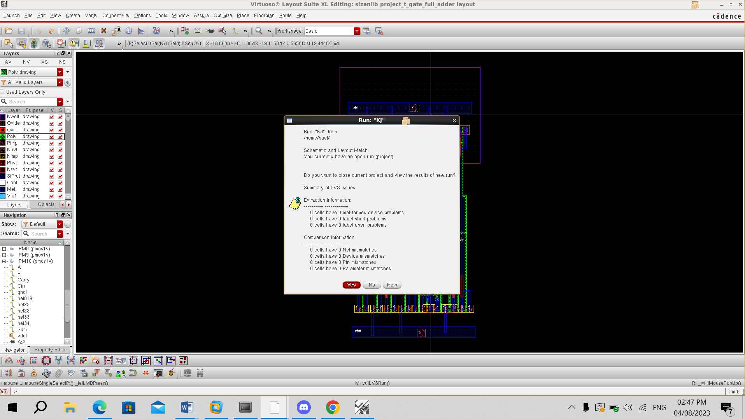
TRANSMISSION GATE
LVS

Slide 19
TRANSMISSION GATE
CELL AREA

Slide 20
FULL ADDER (14T)

Slide 21
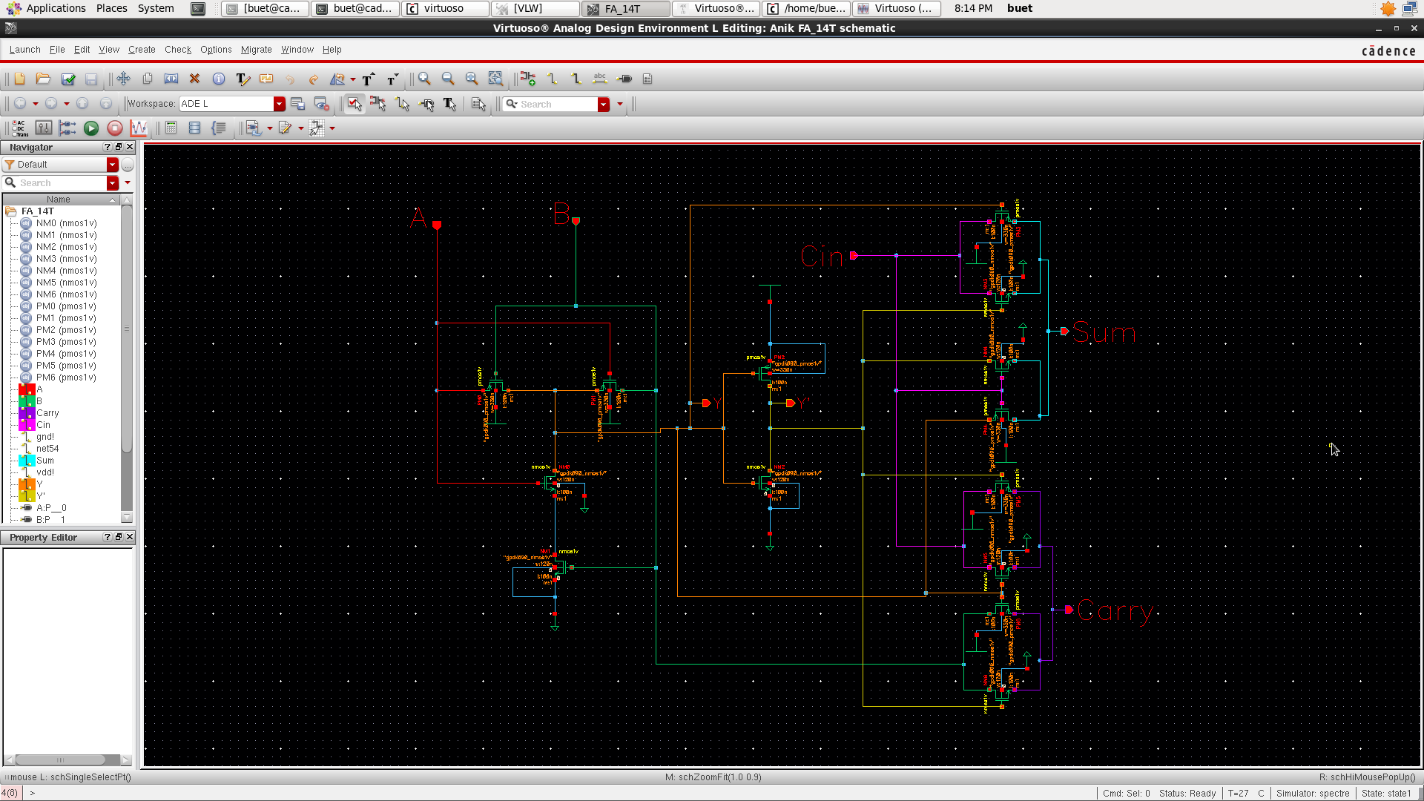
14T FULL ADDER
SCHEMATIC

Slide 22
14T FULL ADDER
INPUT & OUTPUT WAVEFORM

Slide 23
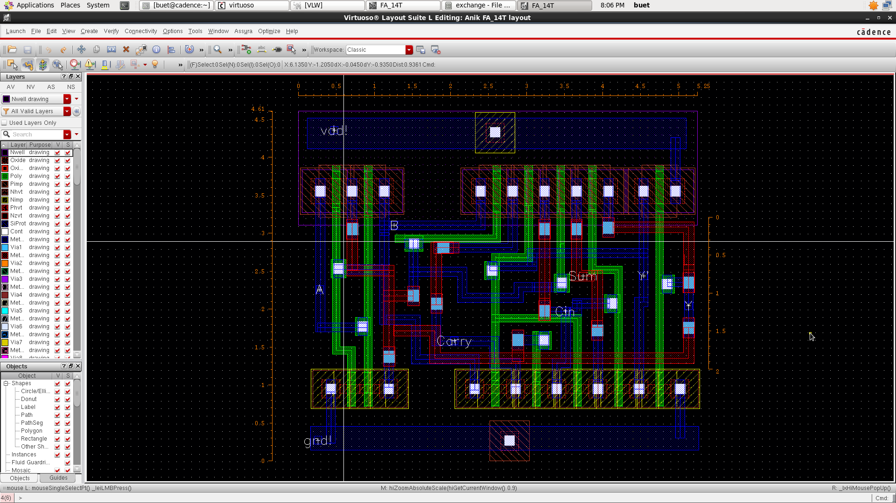
14T FULL ADDER
LAYOUT

Slide 24
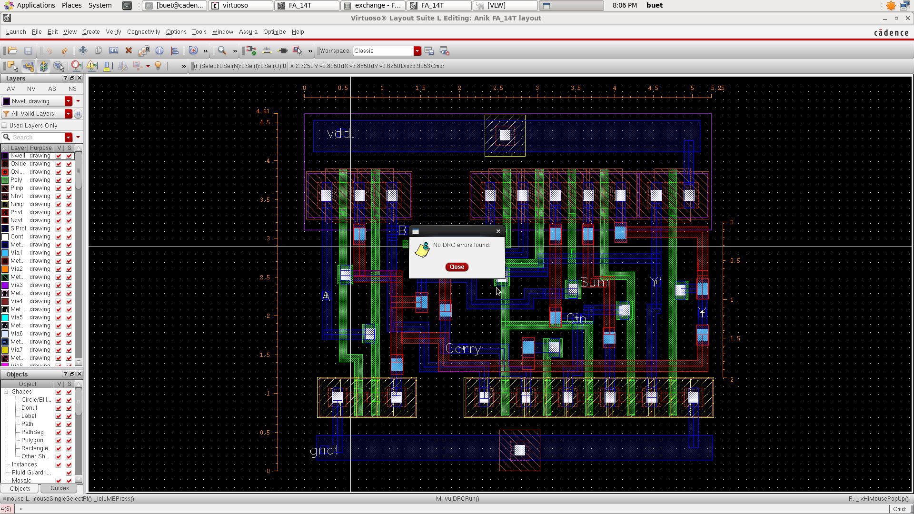
14T FULL ADDER
DRC

Slide 25
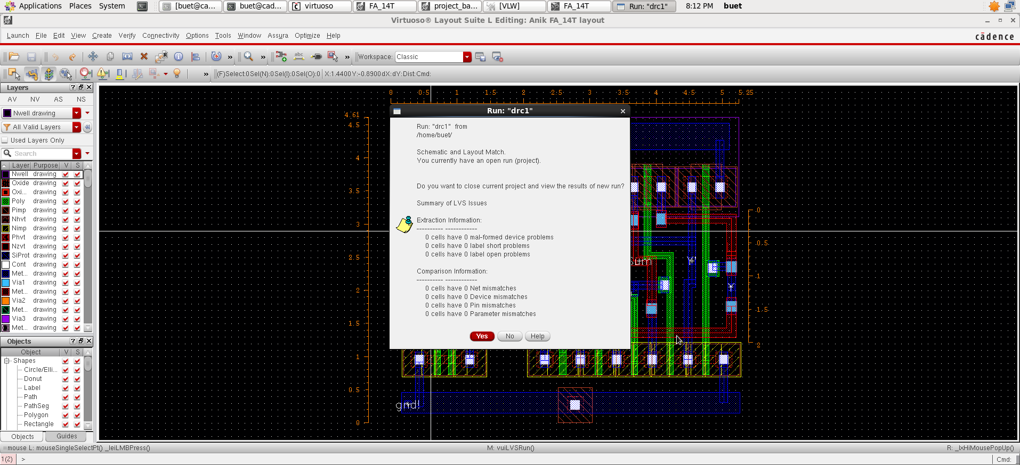
14T FULL ADDER
LVS

Slide 26
14T FULL ADDER
CELL AREA

Slide 27
GATE DIFFUSION
FULL ADDER (10T)

Slide 28
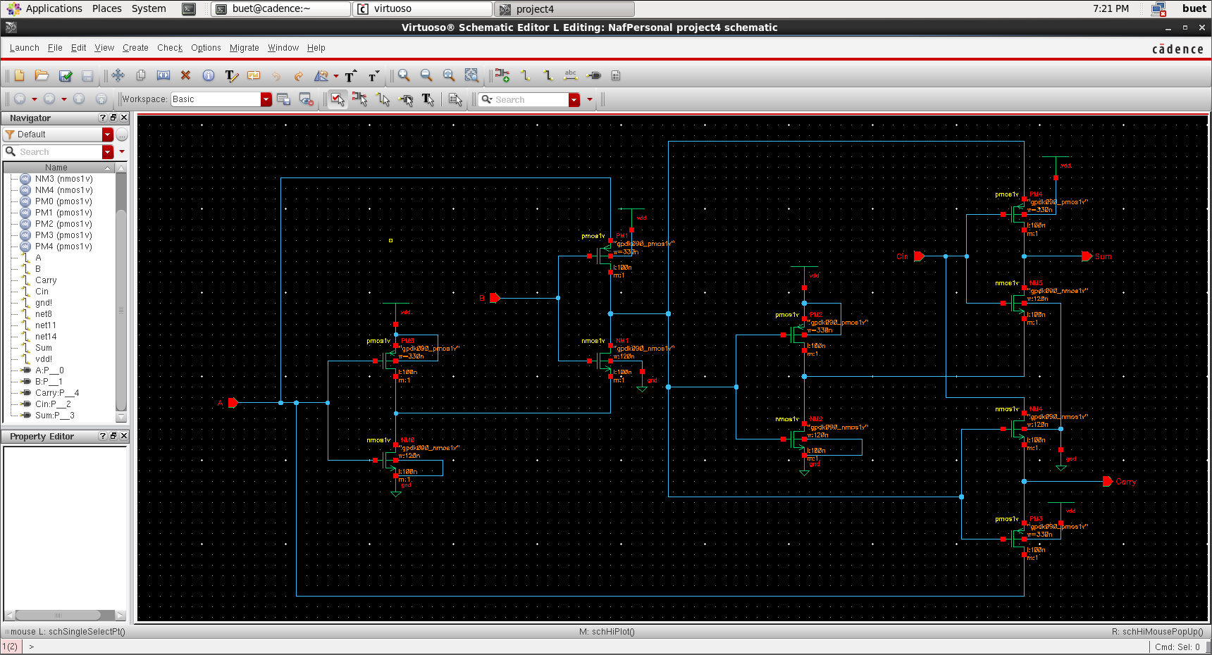
GATE DIFFUSION
SCHEMATIC

Slide 29
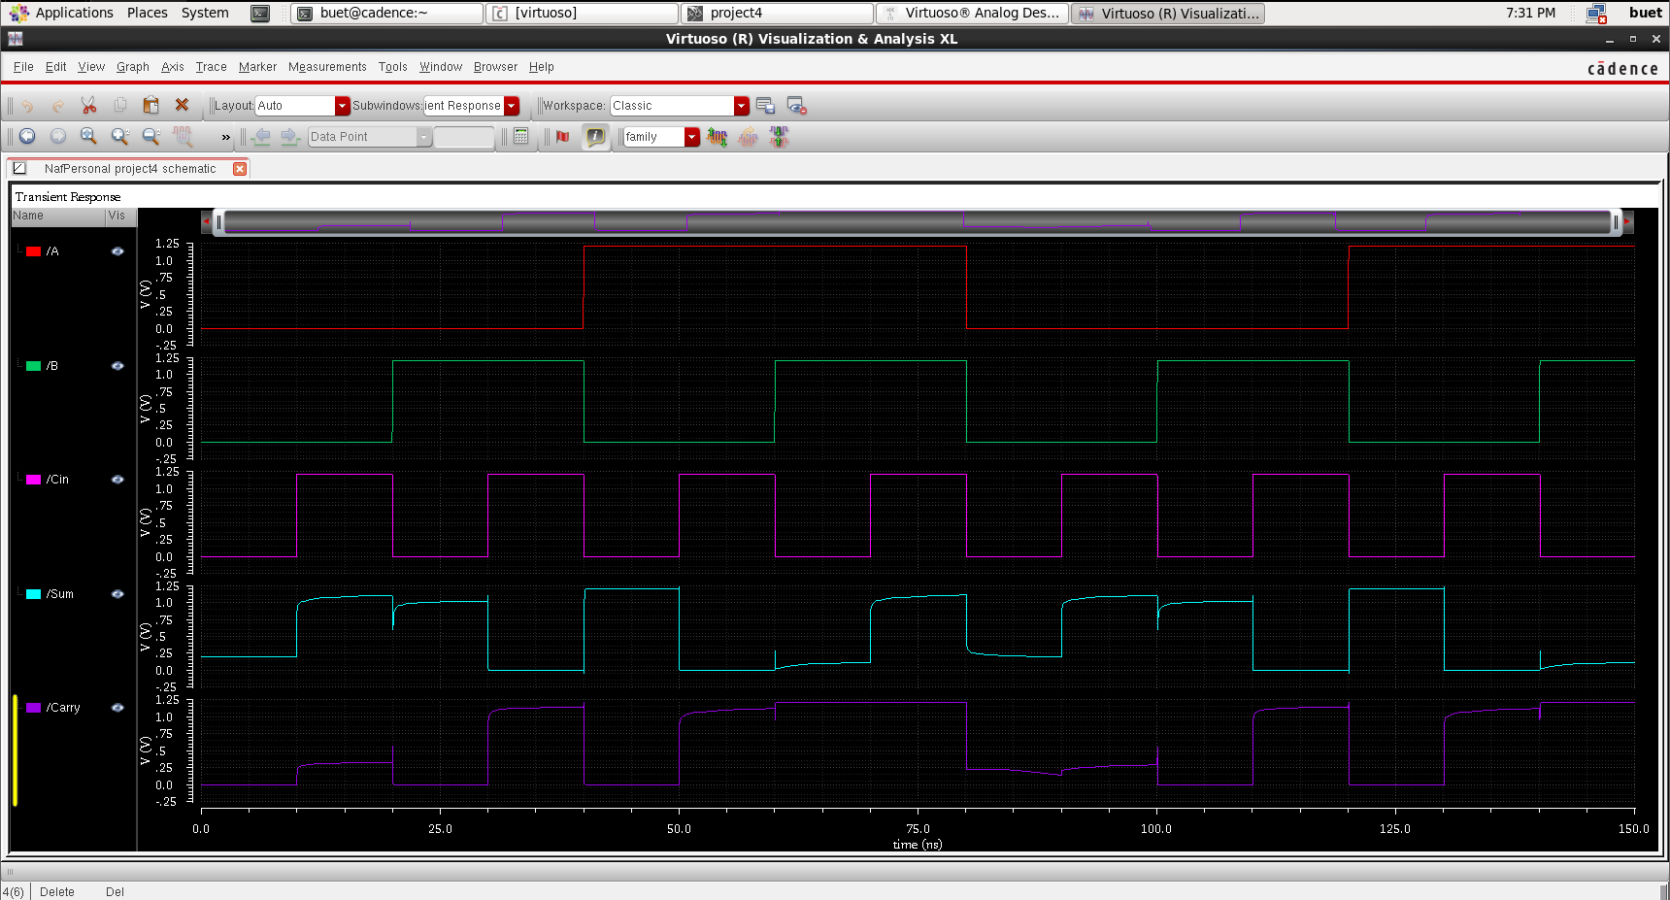
GATE DIFFUSION
INPUT & OUTPUT WAVEFORM

Slide 30
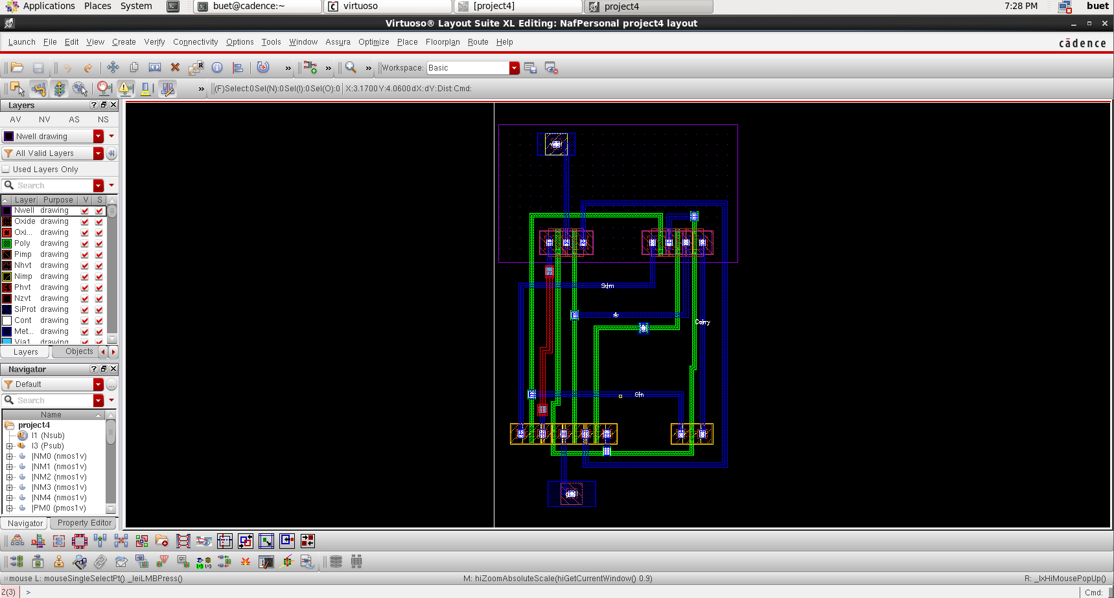
GATE DIFFUSION
LAYOUT

Slide 31
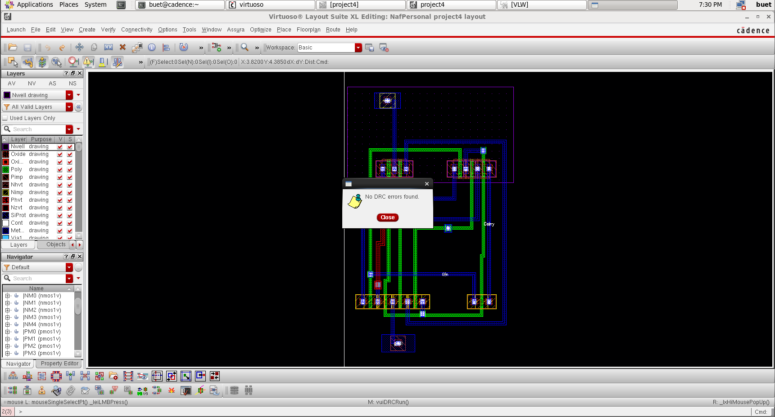
GATE DIFFUSION
DRC

Slide 32
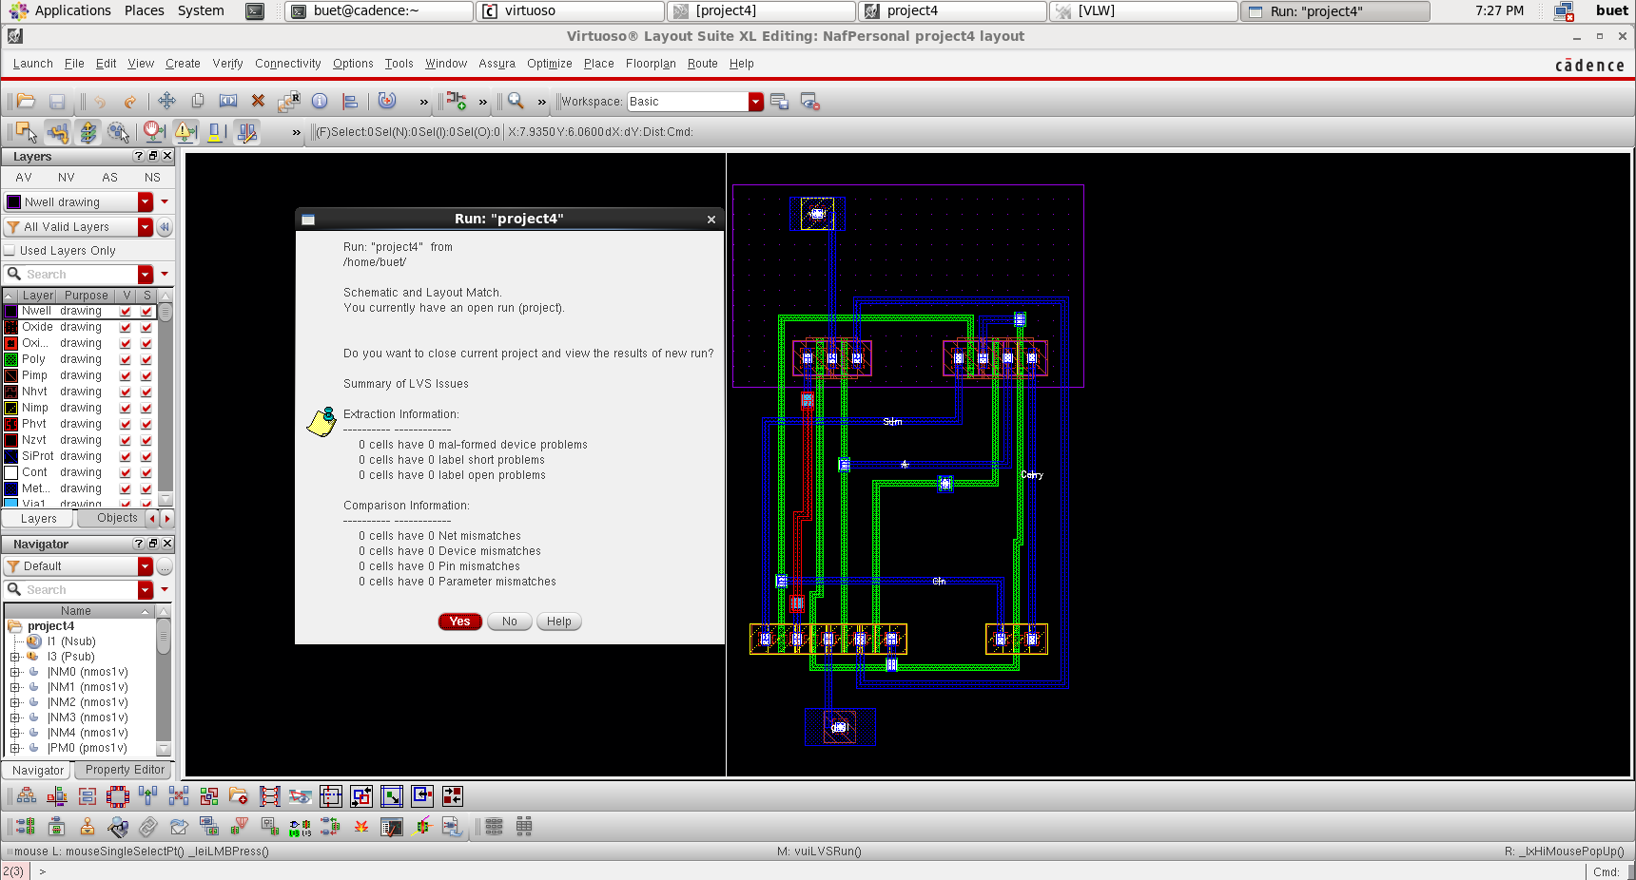
GATE DIFFUSION
LVS

Slide 33
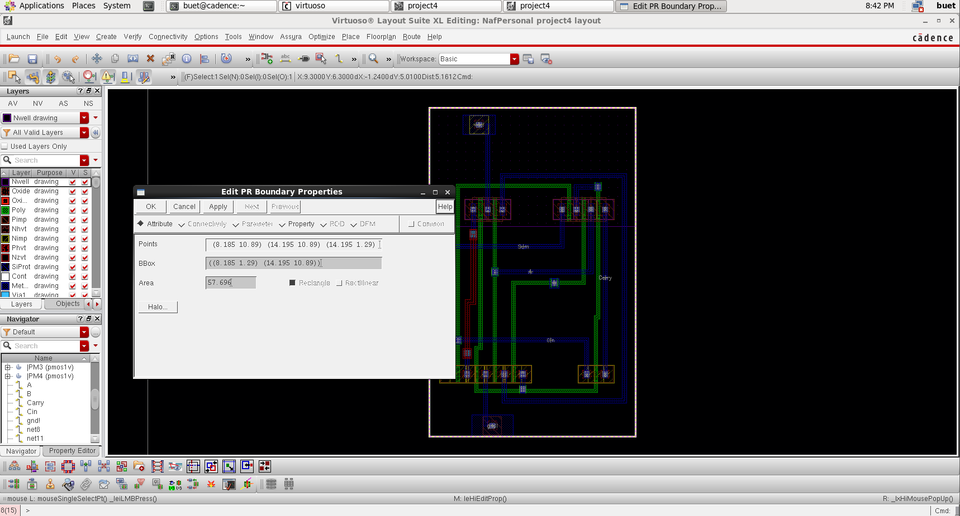
GATE DIFFUSION
CELL AREA

Slide 34
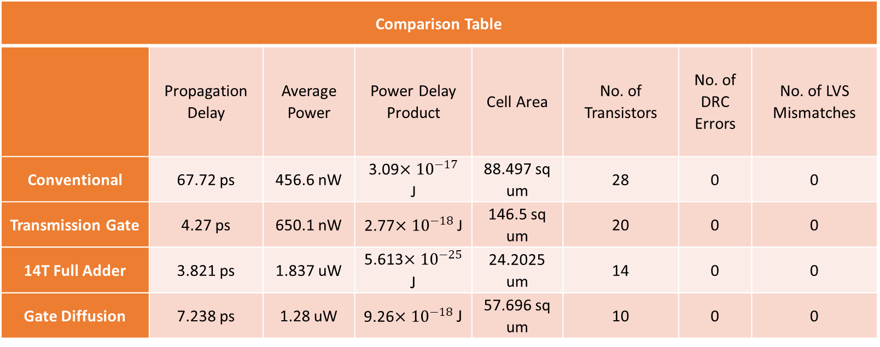
COMPARISON
TABLE
Comparison Table
 | Propagation Delay | Average Power | Power Delay Product | Cell Area | No. of Transistors | No. of DRC Errors | No. of LVS Mismatches
Conventional | 67.72 ps | 456.6 nW | 3.09$×{10}^{−17}$ J | 88.497 sq um | 28 | 0 | 0
Transmission Gate | 4.27 ps | 650.1 nW | 2.77$×{10}^{−18}$ J | 146.5 sq um | 20 | 0 | 0
14T Full Adder | 3.821 ps | 1.837 uW | 5.613$×{10}^{−25}$ J | 24.2025 um | 14 | 0 | 0
Gate Diffusion | 7.238 ps | 1.28 uW | 9.26$×{10}^{−18}$ J | 57.696 sq um | 10 | 0 | 0

Slide 35
CONVENTIONAL
ADVANTAGES
DISADVANTAGES
• Low Power Consumption • Comparatively Simpler in Design • Potentially Faster Operation
• Limited Functionality
• Reduced Noise Margin
• Higher Propagation Delay.

Slide 36
TRANSMISSION GATE
ADVANTAGES
DISADVANTAGES
• [Text] • [Text] • [Text]
• [Text]
• [Text]
• [Text]

Slide 37
14T FULL ADDER
ADVANTAGES
DISADVANTAGES
• [Text] • [Text] • [Text]
• [Text]
• [Text]
• [Text]

Slide 38
GATE DIFFUSION
ADVANTAGES
DISADVANTAGES
• Low Power • Lower Transistor Count • Lower Cell Area
• Signal degradation
• Increased complexity
• Increased propagation delay.

Slide 39
ANY QUESTIONS?

